Slide 1
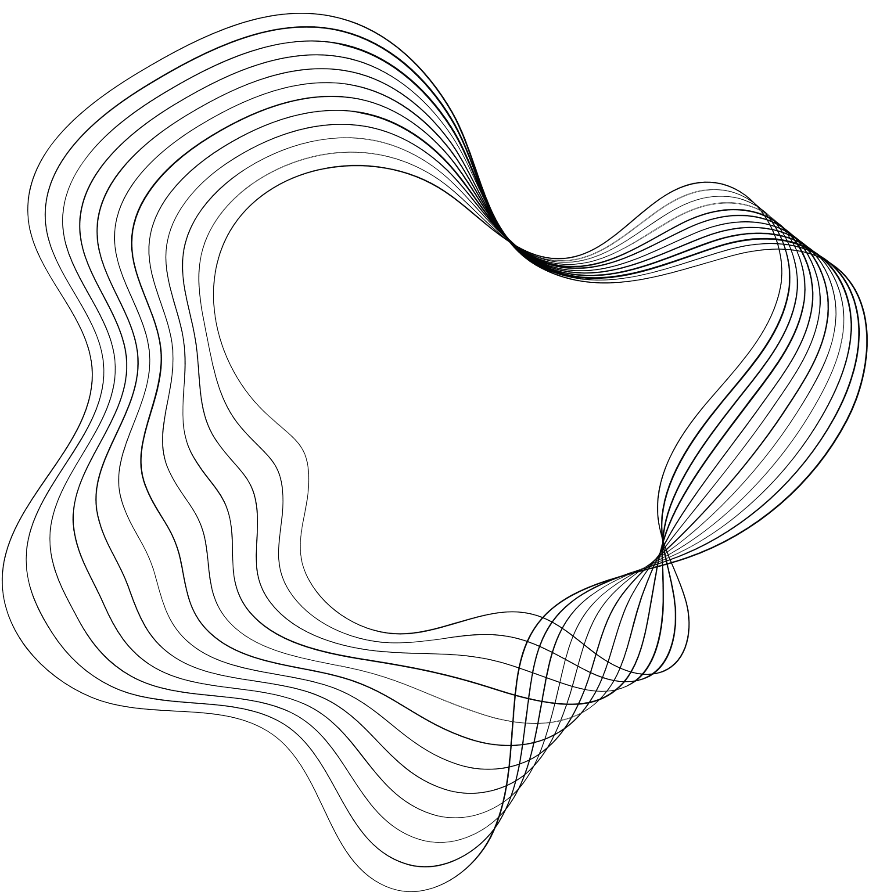
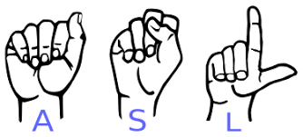
GROUP 6:SIGN LANGUAGE DETECTION :
THE CONCEPTS USED:
DEEP LEARNING
NEURAL NETWORKS
CONVOLUTIONAL NEURAL NETWORK(CNN)
PRESENTED BY:
KIRTIKAA SHARMA (2115800013)
HEMENDRA YADAV (2115800011)
YUGDEEP PARIHAR(2115800033)
SOMIL GUPTA (2115800024)
GUIDED BY (MENTOR):
MS. SUMANA SNIGDHA KESAVARAJU

Slide 2

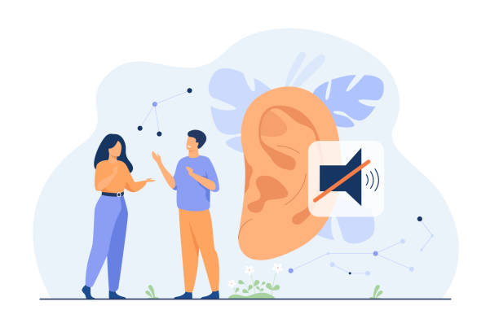
THE PRIMARY REASON :
The primary motivation behind opting for this sign language recognition project is:
To build an ML-based system to help deaf fellow citizens around us to cope with the unwanted communication gap with the rest of the population.

Slide 3

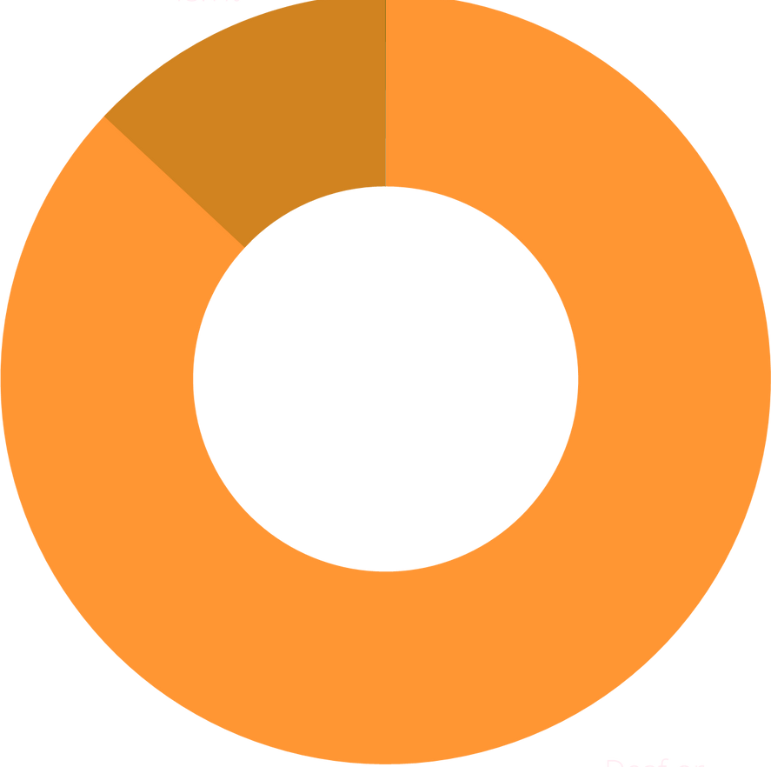
STATISTICS:
ASL
13.1%
According to the World Health Organization (WHO):
Hearing disability - 2005 ~ 278 million
2015 – jumped to 360 million -> roughly 14 % increment.
WHO - 1.5 billion people, 2019.
Could rise to over 2.5 billion by 2050.
Deaf/ Mute
86.9%

Slide 4

OBJECTIVE :
To eliminate the need for a sign language interpreter by making the best possible use of CNN to build a proficient project that accurately recognizes the majority of the symbols/patterns used in everyday sign language (ASL).
Why we chose CNN to achieve this goal? :
We decided to use CNN for implementing this project basically due to the high proficiency of this technology in dealing with image/pattern recognition and tracking i.e. in solving computer vision problems.

Slide 5
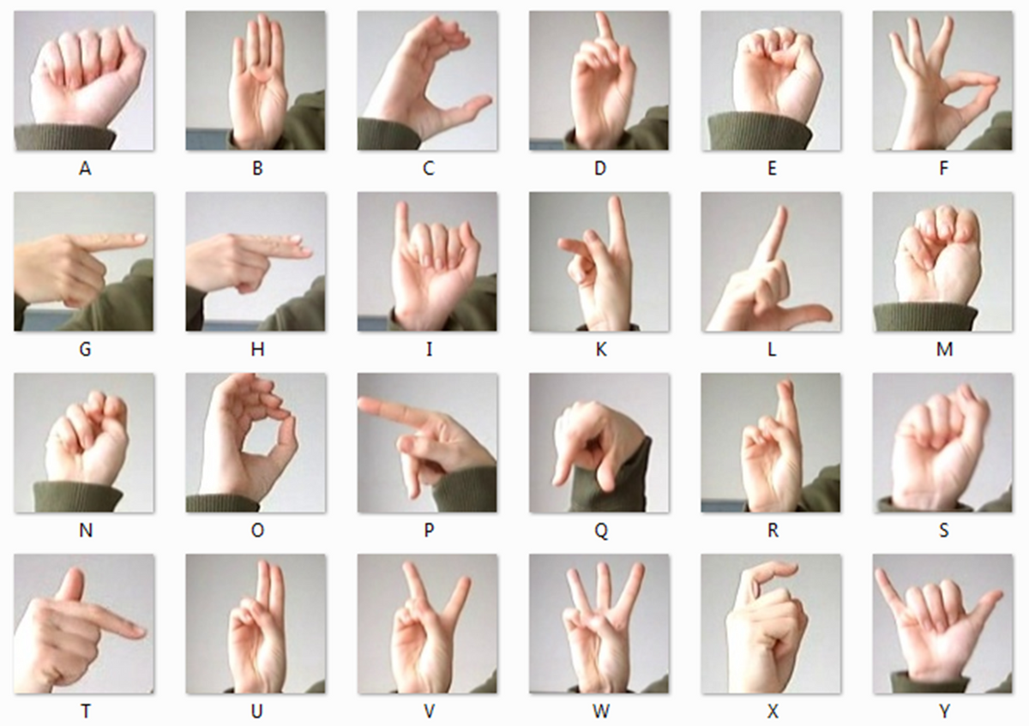
DATASET
MNIST
Vision
Modified National Institute of Standards and Technology

Slide 6
IMAGES PROCESSING
CREATING OUR X AND OUR Y
SCALING OUR IMAGES
RESHAPING OUR IMAGES
DISTRIBUTION OF LABELS

Slide 7


CNN MODEL
01
02
03
SPLITING TRAINING DATA
CREATING MODEL
TRAINING MODEL

Slide 8

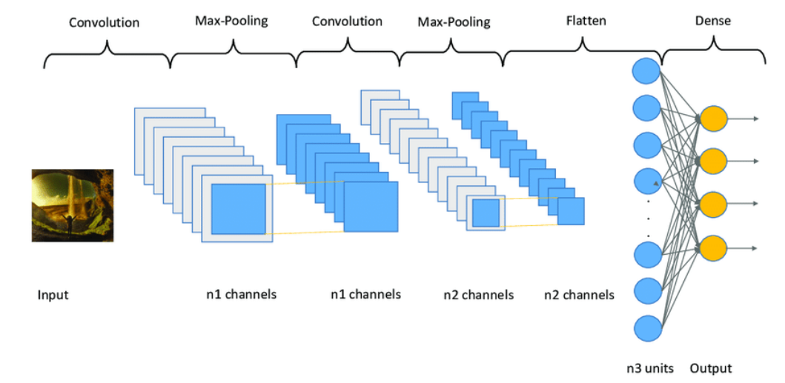
CONVOLUTION LAYERS

Slide 9
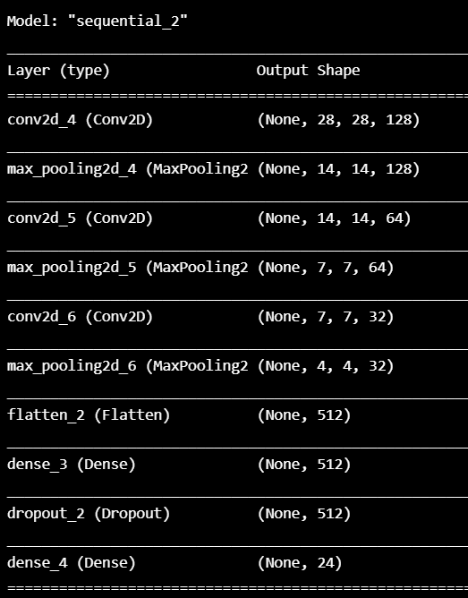
MODEL
SUMMARY

Slide 10
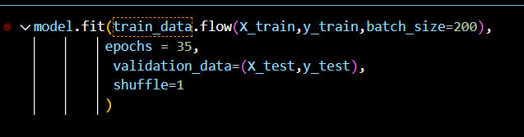
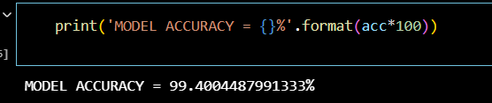
TRAINING
ACCURACY

Slide 11
FUTURE SCOPE
WE ARE PLANNING TO ACHIEVE HIGHER ACCURACY EVEN IN CASE OF COMPLEX BACKGROUNDS
AND IN LOW-LIGHTING AREAS
THE FUTURE SCOPE OF SIGN LANGUAGE RECOGNITION INCLUDES ADVANCEMENTS IN ARTIFICIAL INTELLIGENCE, COMPUTER VISION, AND MACHINE LEARNING TO IMPROVE ACCURACY AND
SPEED RECOGNITION. WE ARE PLANNING TO MAKE A APPLICATION IT CAN HELP BRIDGE COMMUNICATION GAPS BETWEEN INDIVIDUALS WHO ARE DEAF OR HARD OF HEARING AND THOSE WHO ARE NOT

Slide 12


THANK’S YOU
If you have any question feel free to ask !!

